Slide 1

Human Robot Interaction HR Robot
Presented to: Br. Elie Saad
Presented by:
Christian Tauk
Maher Halabi
Goerges Sarkis
Georges Saad

Slide 2
Use Case analysis
US01: Initiate interaction
1
US02: Conduct Survey and Show Results
2
US03: Conduct Quiz and Show Results
3
US04: End Interview
4

Slide 3
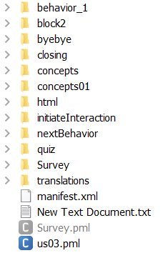
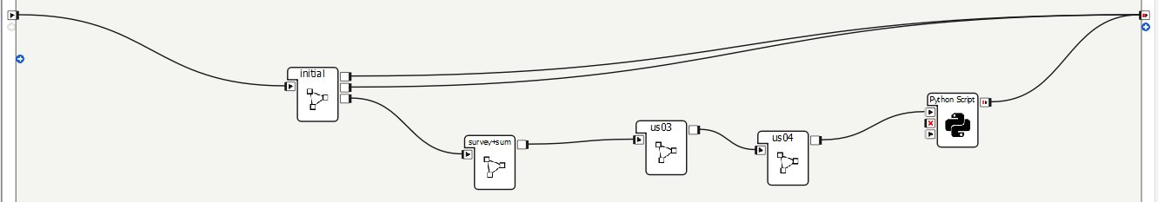
Use Case Connections

Slide 4
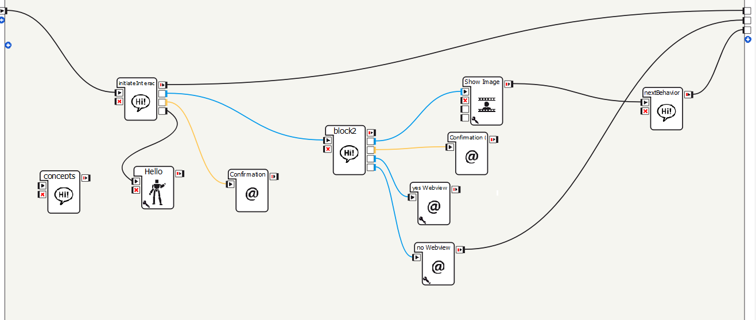
Use case1: Initiate interaction

Slide 5
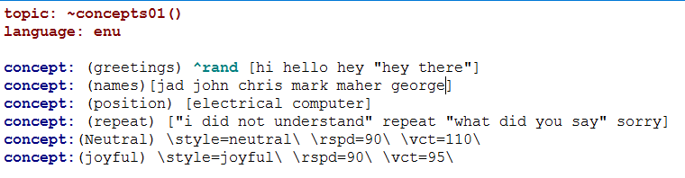
Use case1: concepts01 (Dialogue box)

Slide 6
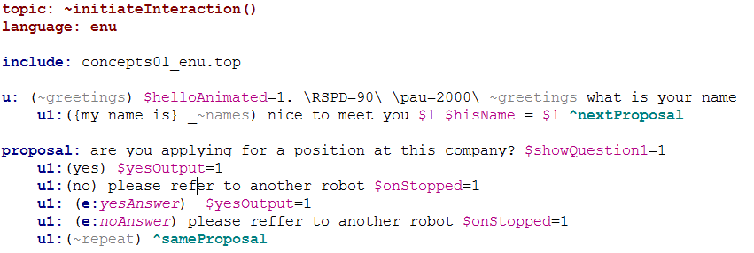
Use case1: initiateInteraction (Dialogue box)

Slide 7
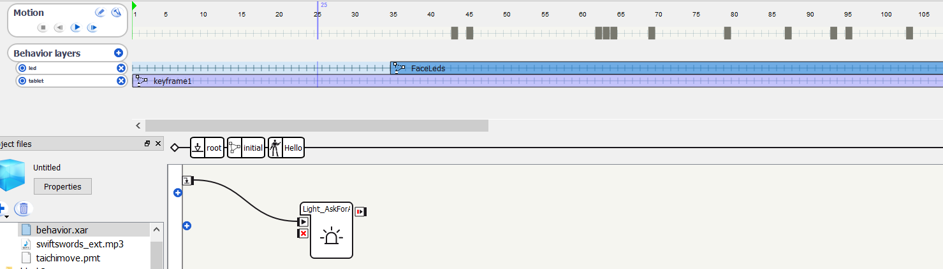
Use case1: Hello (animated box)

Slide 8
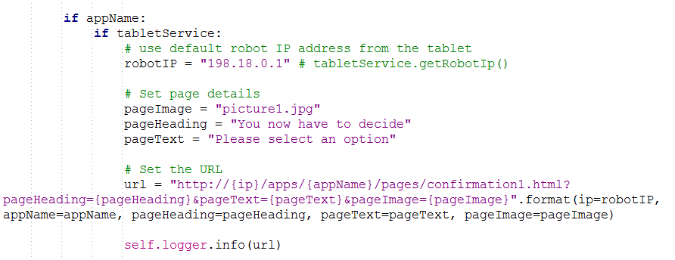
Use case1: Confirmation (WebView)

Slide 9
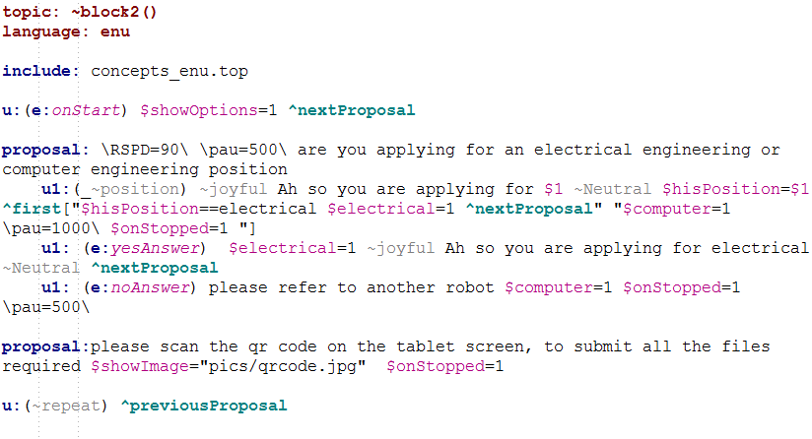
Use case1: block2 (Dialogue box)

Slide 10
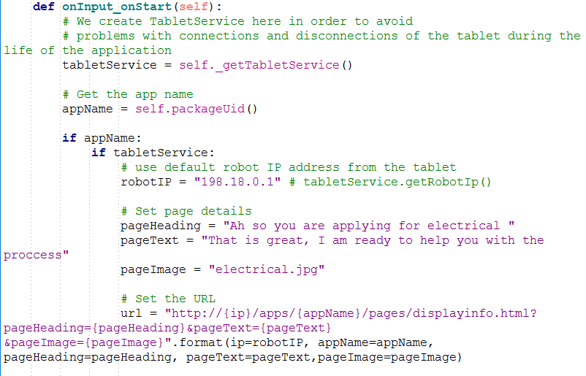
Use case1: yes WebView

Slide 11
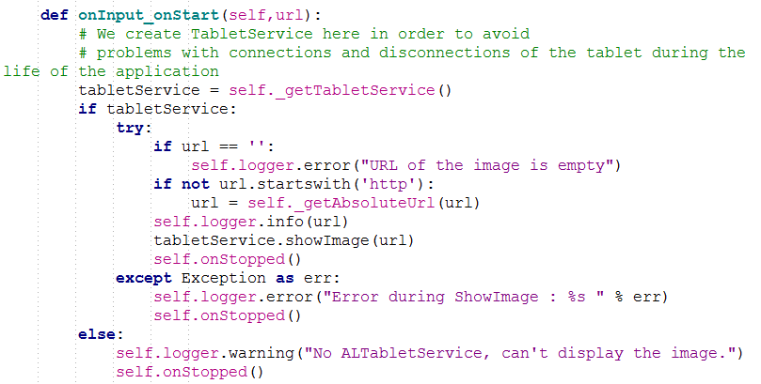
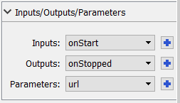
Use case1: Show image (WebView)

Slide 12
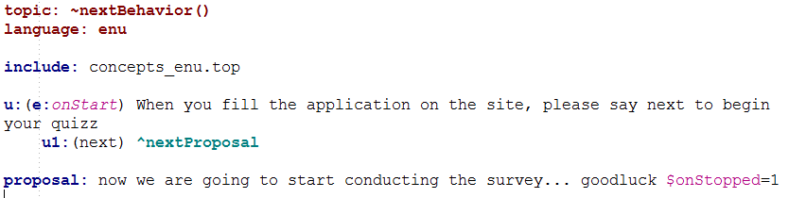
Use case1: nextBehavior (Dialogue box)

Slide 13
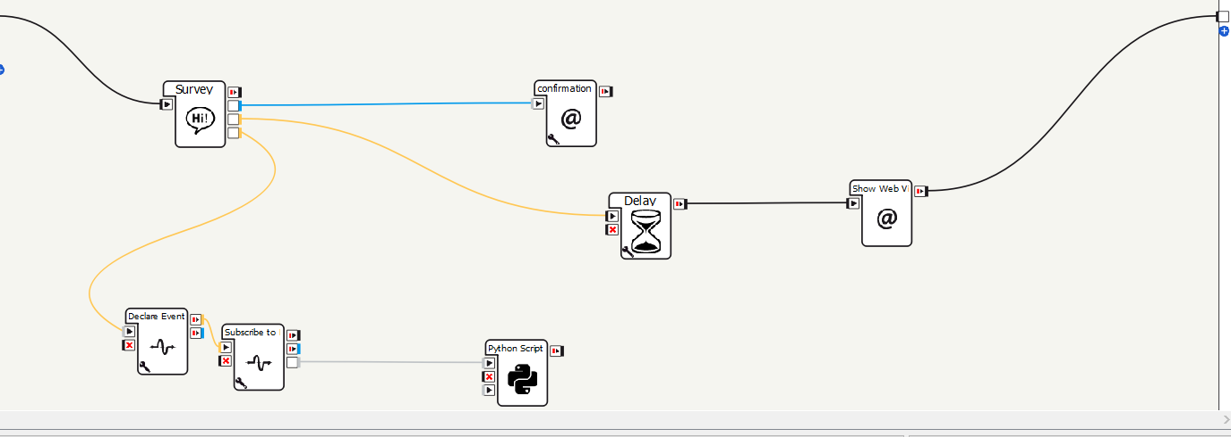
Use case 2: Survey and sum

Slide 14
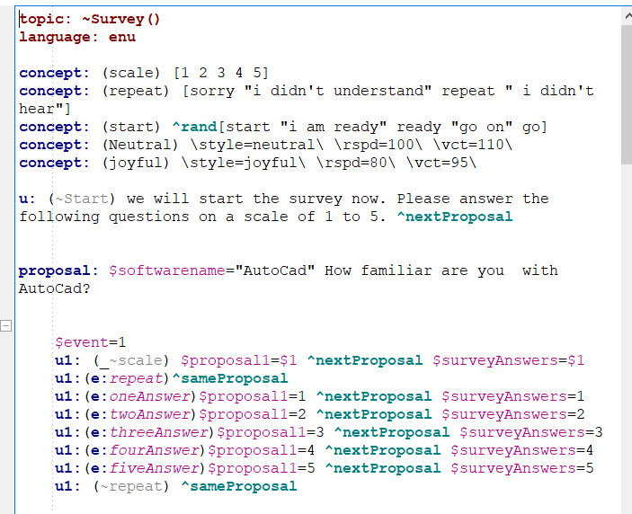
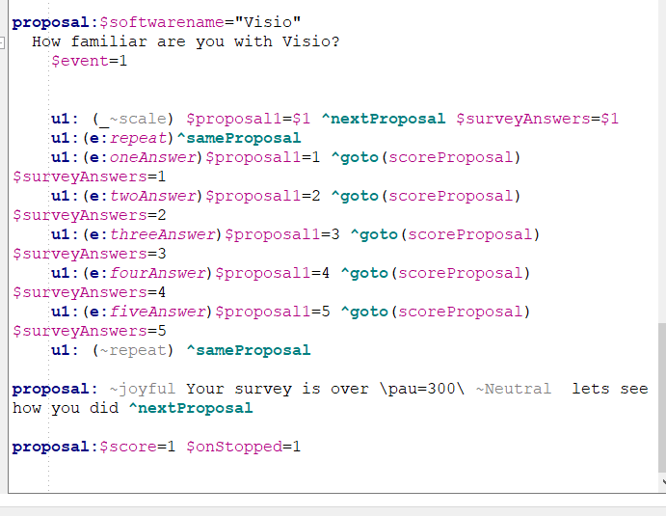
Survey dialogue

Slide 15
Summation
First, we subscribe to an event in survey.
We pull the value.
Add it to the old one
Save it

Slide 17
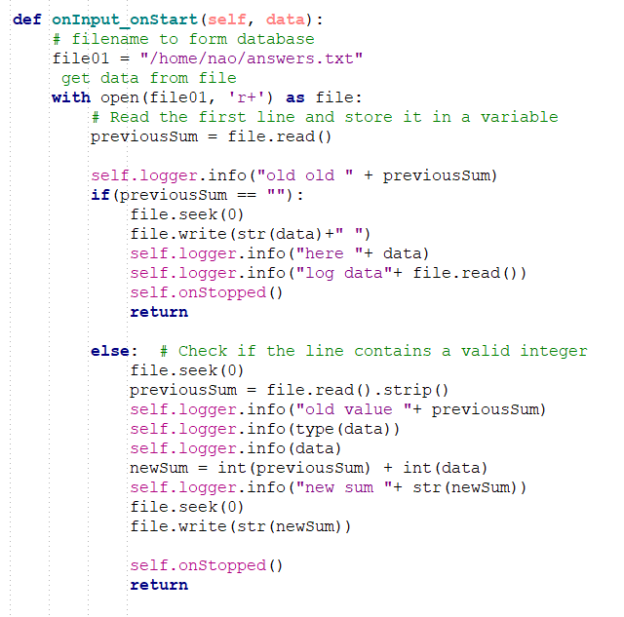
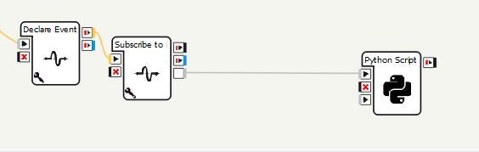

Slide 18
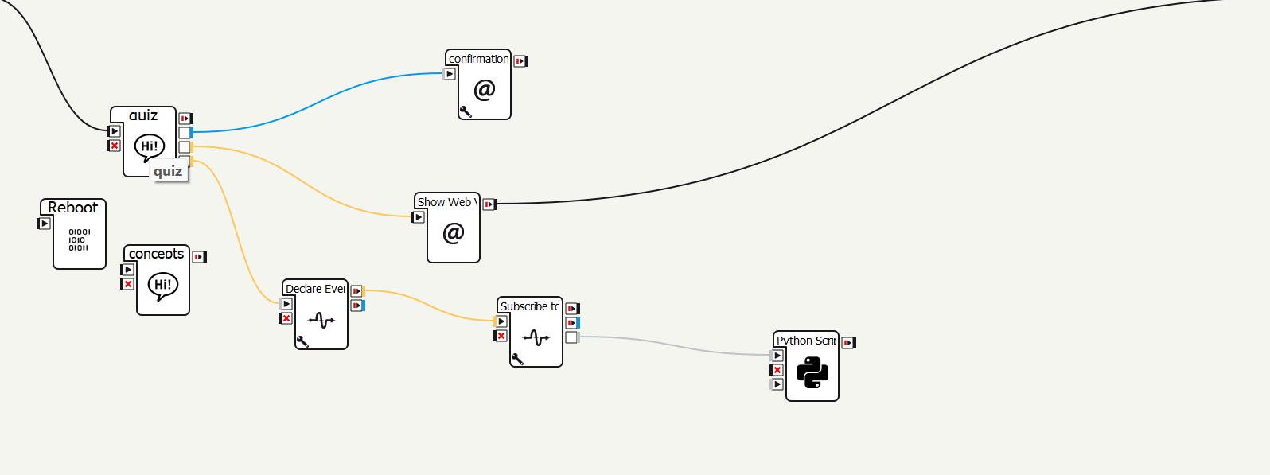
Use case 3
Conduct Quiz and Show Results

Slide 19
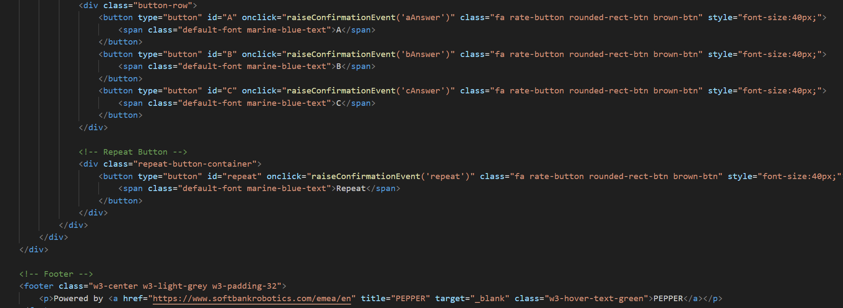
Html code for raising event
Here we have 3 buttons we game id A for the 1st / B for the 2nd / C for the 3rd
For each button we raised an event with the names aAnswer / bAnswer / cAnswer
And we added a button at the bottom caled repeat with and event called repeat

Slide 20
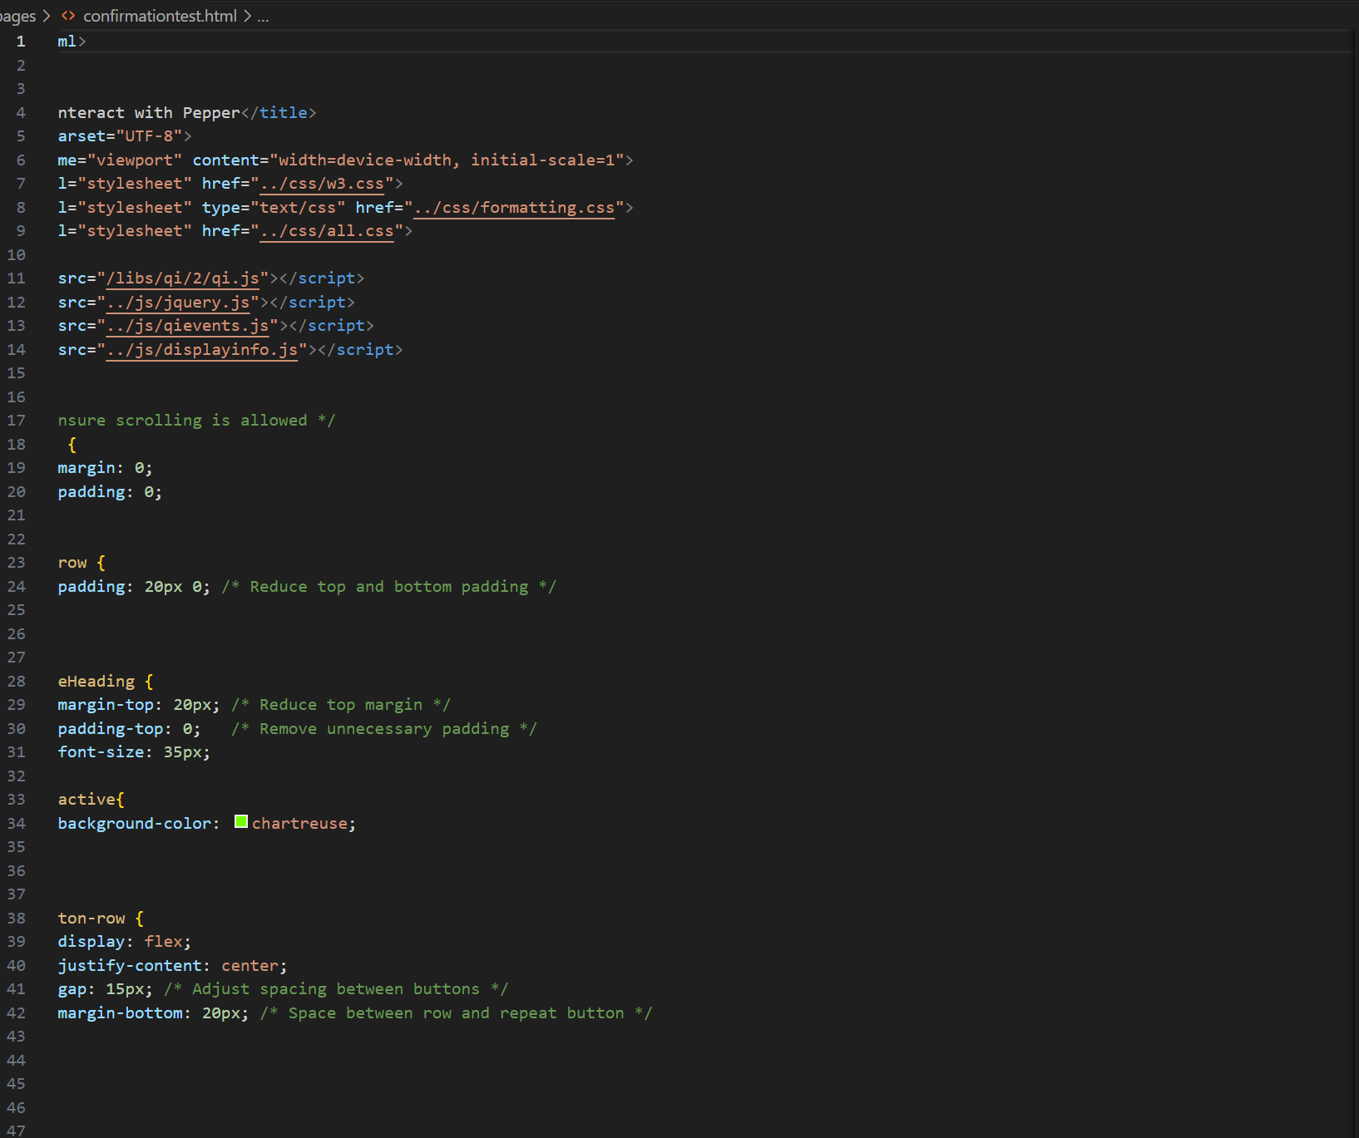
Html code for confirmationTest

Slide 21
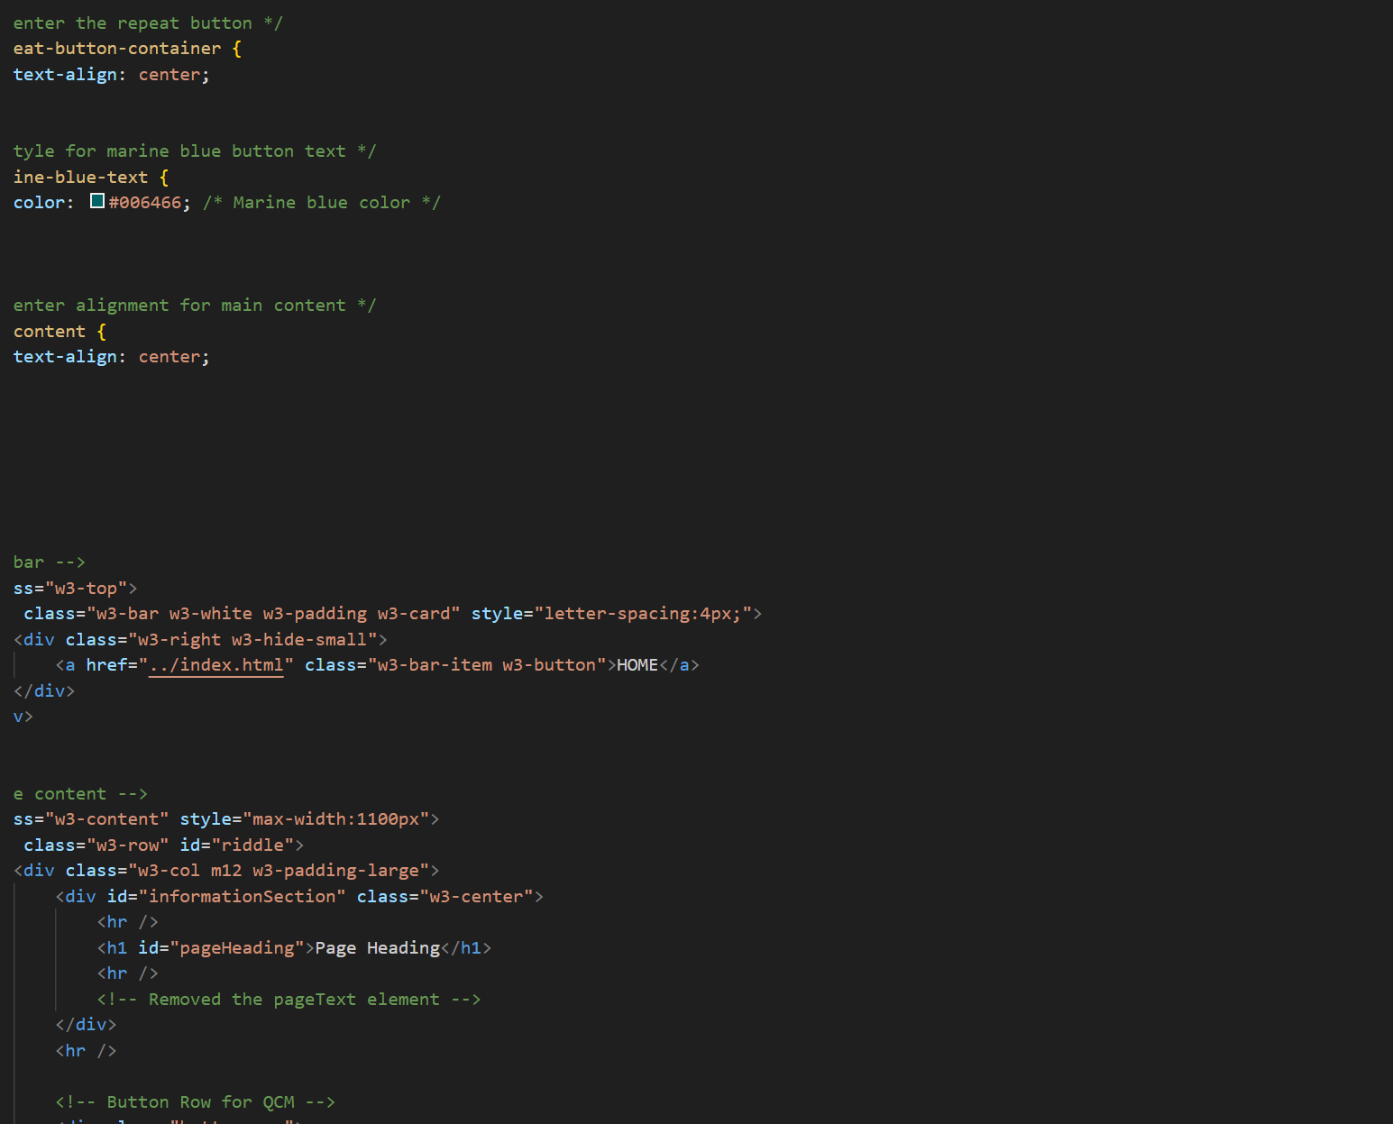

Slide 22
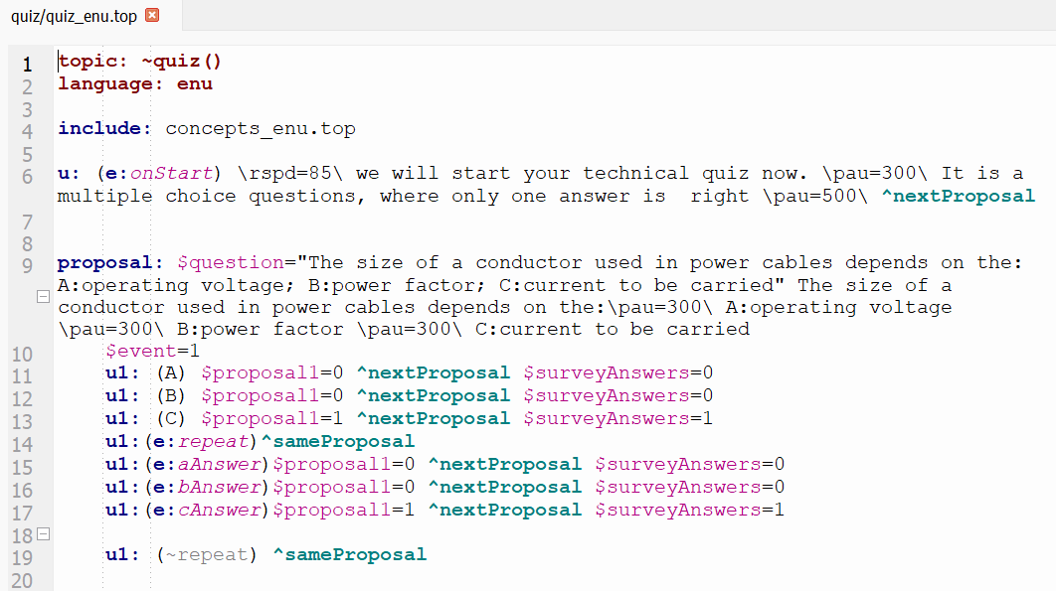

Choregraphe
Dynamic page Heading
Start action with event raised
Rspd / pau
Joyful theme

Slide 23
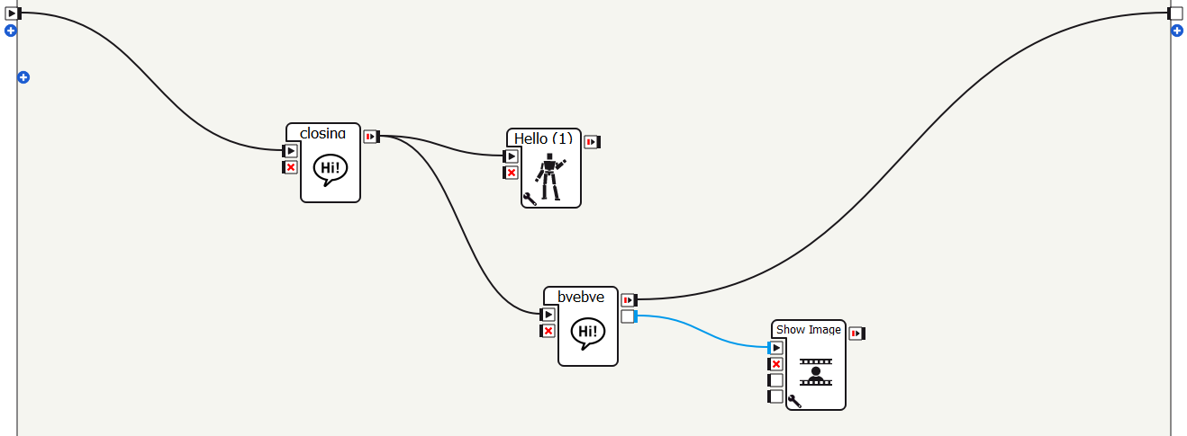
Use case 4
Final use case
Show contact information
Delay

Slide 24

THANK YOU

